Slide 1
Dashboard on Telecom Users Dataset Report
By : Pawan V. Walke
Batch : Mar '21 Batch 1

Slide 2
OBJECTIVE
To create Dashboard based on Telecom Users Dataset Report

Slide 3
INTRODUCTION
The telecommunication sector is made up of companies that make communication possible on a global scale, whether it is through the phone or the Internet, through airwaves or cables, through wires or wirelessly. These companies created the infrastructure that allows data in words, voice, audio, or video to be sent anywhere in the world. The largest companies in the sector are telephone (both wired and wireless) operators, satellite companies, cable companies, and Internet service providers.

Slide 4
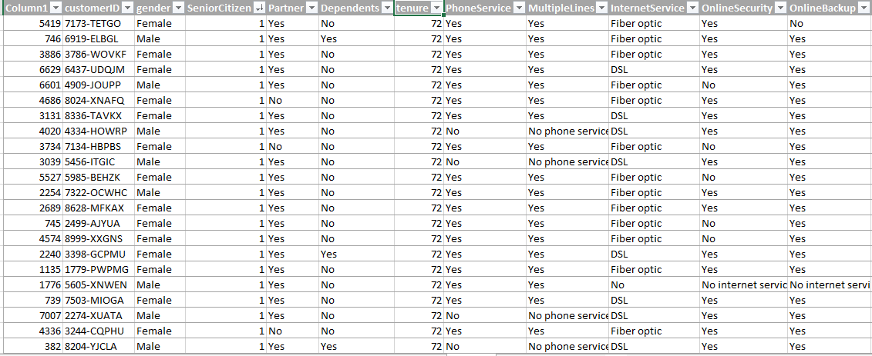
Dataset
DATASET contains 21 columns and 5986 rows.

Slide 5

Pivot Table 1
Problem statement:
To find Count of Male and Female Customer.

Slide 6

Pivot Table 2
Problem statement:
To find Count of Type of internet service users.

Slide 7

Pivot Table 3
Problem statement:
To find out the Contract of the Customers.

Slide 8

Pivot Table 4
Problem statement:
To track the Online Security of the Customers.

Slide 9
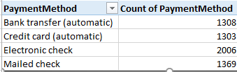
Pivot Table 5
Problem statement:
To track the Payment Methods of Customers

Slide 10

Pivot Table 6
Problem statement:
To find out how many people use Streaming Movies.

Slide 11

Pivot Table 7
Problem statement:
To find out how many people use Streaming TV.

Slide 12

Pivot Table 8
Problem statement:
To find out how many people have online Backup

Slide 13
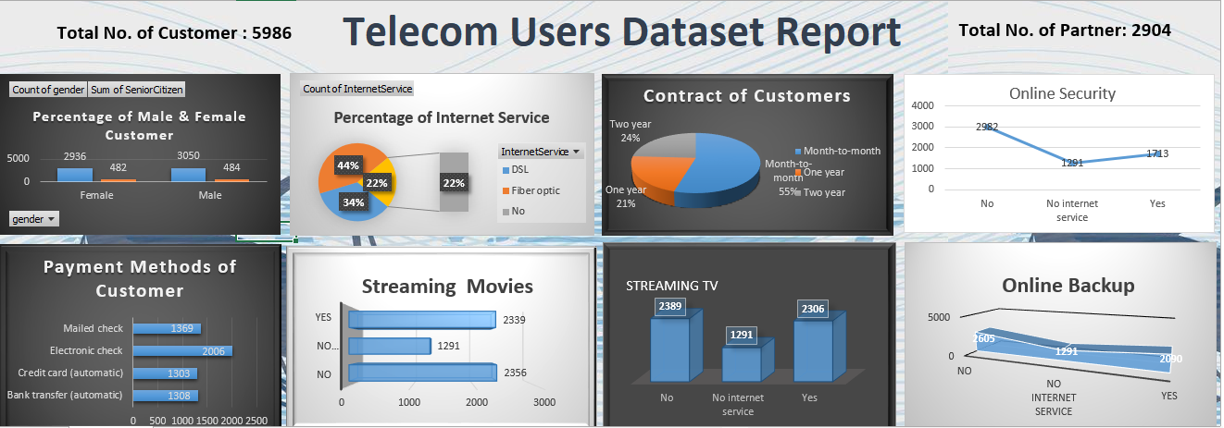
Dashboard

Slide 14
Conclusion
As Comparative female user, internet service male users are more use.
Most of the people prefer fiber optics service.
Most of the users prefer month to month payment contract.
Most of the people haven’t use online security.
Most of the people prefer electronics check mode.

Slide 15
Video Link
https://drive.google.com/file/d/1SMjuF0oaVG5ROTvIFaqTfiuGYF0llwQ1/view?usp=sharing

Slide 16
Thank You

